Slide 1
Mojaloop Planning Day #4 PI-18 Workstream Feedback Session – 27 April 2022 Presenters Kim Walters

Slide 2
Mojaloop Orientation
History – a look back
Why open Source
Roadmap and Planning

Slide 3
Why Open Source
Open source licensing encourages innovation through collaboration.
Open Source (w/ the right community is):
Cost Effective
Highly Reliable
Scalability
Secure
High Quality
Without it, many of the technologies we take for granted today would never have developed

Slide 4


Timeline
Mojaloop Branding
Road To Production
ML Phase3
ML Phase4
ML Phase5
Today
SIBOS 2017
Productionization
Kick-off
Kickoff
Q1 2020
Johannesburg
Kickoff
Q1 2021
Remote
ML PI-18
Q3 2017
Q1 2018
Q1 2019
Q1 2022
03
04
PI-07
PI-07
PI-13
2016
2017
2018
2019
2020
2021
2022
Q1
Q2
Q3
Q4
Q1
Q2
Q3
Q4
Q1
Q2
Q3
Q4
Q1
Q2
Q3
Q4
Q1
Q2
Q3
Q4
Q1
Q2
Q3
Q4
Q1
Q2
Q3
Q4
01
02
05
PI-06
PI-08
PI-9
PI-16
LevelOneProject
PDP Project
FSPIOP Spec 1.0
End of Phase2
End of Phase3
End of Phase4
End of Phase5
L1P Kick-off
PDP Kick-off
Released to the public
ML Phase-2 wrap-up
ML Phase-3 wrap-up
ML Phase-4 wrap-up
ML Phase-5 wrap-up
Q3 2016
Q4 2016
Q1 2018
Q3 2018
Q3 2019
Abidjan
Q3 2020
Remote
Q3 2021
Remote

Slide 5
PI-Schedule

Slide 6
Whats Next
Foreign Exchange Support
ISO 20022 Enhancements
Fraud Tool Integration
Merchant Payments
Enhanced MSISN Routing
New Operator Portals
L1-Compliant Mandates
Bulk Payments
PISP (AISP)
New Settlement Models
Payment Manager Extensions
Onboarding, Infra & DevOps (Mojaloop-in-a-box/MiniLoop)
Paul to review topics
Ask Questions
Vote
Lunch
Breakouts
Report-outs

Slide 7
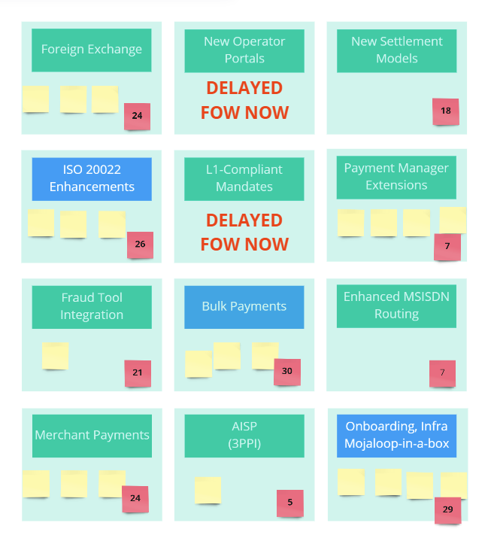
Voting Results
Report Outs
ISO 20022
Bulk Payments
Onboarding, Infra, Mojaloop-in-a-box
What Next
Deeper PI-Planning next week
Owners noted in wrap-up email
Get involved in the workstreams!

Slide 8
Thank you Questions and comments
muchas gracias

